Slide 1
INHERITANCE IN DOTNET(C#)
BY
UMAYAMBIGAI DURGA R
12MCS039
II MSC(CS)

Slide 2
Inheritance
Creating a new class from existing class is called as inheritance. //All the car properties can be used by the supercar
class Supercar : car
{
}
When a new class needs same members as an existing class, then instead of creating those members again in new class, the new class can be created from existing class, which is called as inheritance.

Slide 3
Types of inheritance
Single Inheritance
Hierarchical Inheritance
Multi Level Inheritance
Hybrid Inheritance
Multiple Inheritance

Slide 4
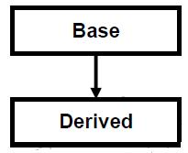
Single inheritance
when a single derived class is created from a single base class then the inheritance is called as single inheritance.

Slide 5
Single Inheritence example in C#
class A
{
public void displayBase() { System.Console.WriteLine(“BaseClass"); }
}
class B : A //b is child of a
{
public void displayDerived() { System.Console.WriteLine(“DerivedClass"); }
}
class C
{
public static void Main() {
B x=new B();//Normally object of child
x.displayBase();
x.displayDerived();
}
}

Slide 6
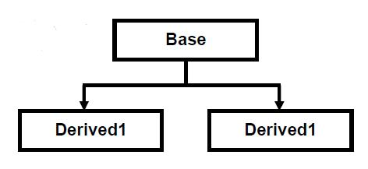
Hierarchical Inheritance
when more than one derived class are created from a single base class, then that inheritance is called as hierarchical inheritance.

Slide 7
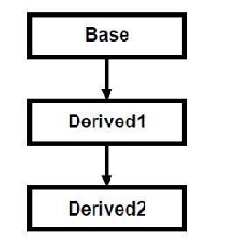
Multi Level Inheritance
when a derived class is created from another derived class, then that inheritance is called as multi level inheritance.

Slide 8
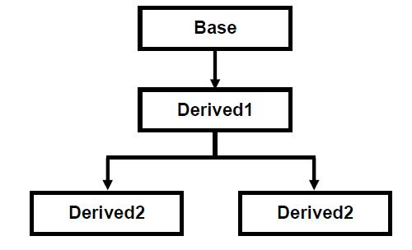
Hybrid Inheritance
Any combination of single, hierarchical and multi level inheritances is called as hybrid inheritance.

Slide 9
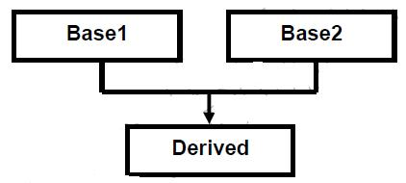
Multiple Inheritance
when a derived class is created from more than one base class then that inheritance is called as multiple inheritance.
But multiple inheritance is not supported by Dotnet using classes and can be done using interfaces.

Slide 10
Advantages of inheritance
Inheritance hierarchy represents an is-a relationship and not a has-a relationship.
can reuse code from the base classes.
Easy understanding
Fast implementation in time

Slide 11
Thank you!!

